Slide 1

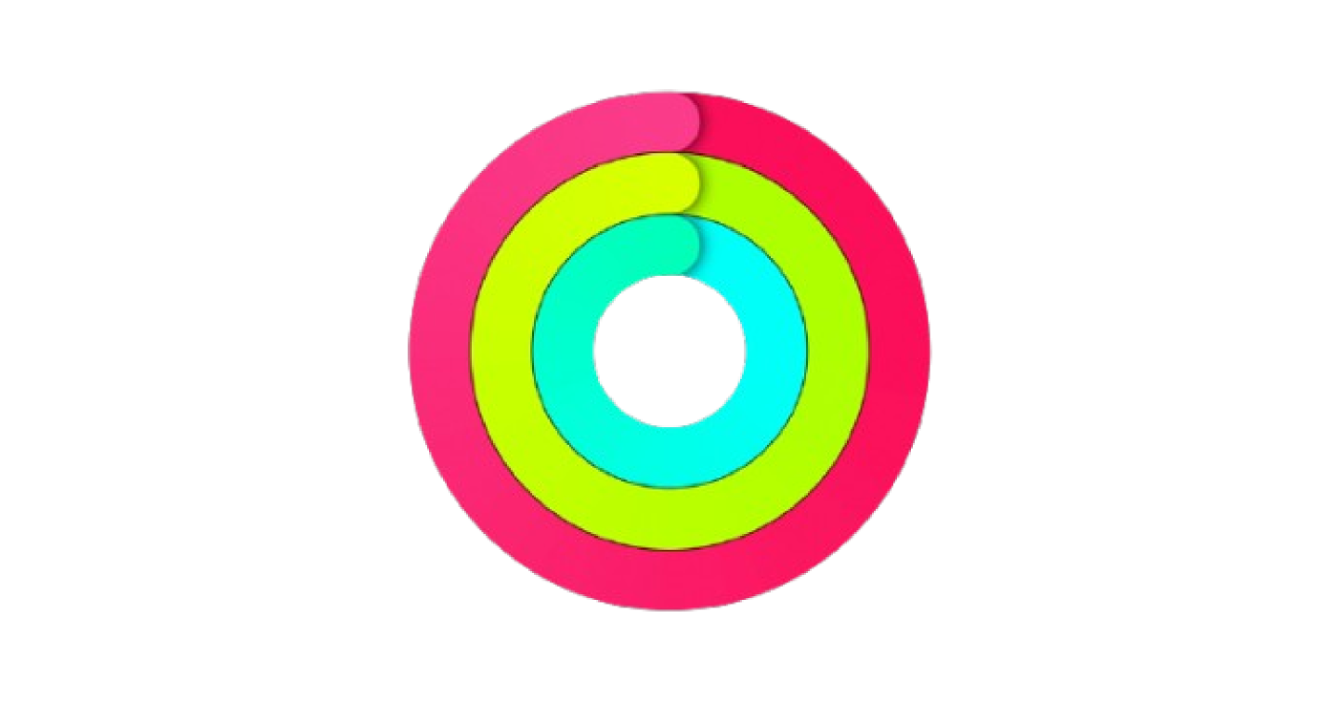
Apple Health
Product Team Final Presentation
By Prateek Nedungadi

Slide 2

Table of Contents
01
02
03
Health
Overview of Health
User Research
Ideation
04
05
06
Value Proposition
Feature Solution
Development Plan
2

Slide 3
NYU — PMC
Intro to Company
3

Slide 4
Business Analysis
Product and Services
  Main product: Apple Health app—tracks health stats
  Additional: Apple Watch—passive tracking
  Subscription: Apple Fitness—workout subscription
  Integration and secure data encryption
Business Model (Revenue Streams)
  Primarily Watch, AirPods, iPhone sales
  Optional subscriptions: Apple Fitness+, iCloud storage plans
  Secondary: HealthKit API commissions, AppleCare premiums
  Partnerships with medical institutions and medtech acquisitions for expanded features
NYU — PMC
Unique Selling Proposition (USP)
  Seamless integration of Apple Health with Apple hardware (Watch, AirPods, iPhone) and third-party apps for passive health tracking
  Aggregates, visualizes, and encrypts data into unified dashboards (pie charts, bar graphs, scores) for frictionless use
  Stands apart with privacy, cross-device cohesiveness, and clinical-grade regulated features other niche apps lack
4

Slide 5
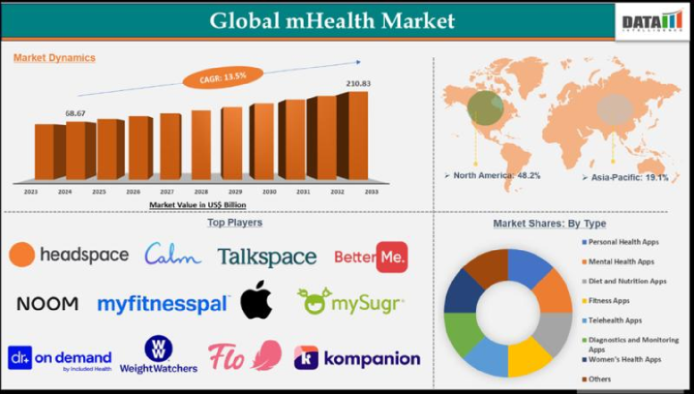
Business Analysis
Market Analysis
Digital health market: $79B (2024), 11.7% annual growth
Apple: ~20% wearables market share
Trends: wearables, privacy, ecosystem integration
Main competitors: MyFitnessPal, Google Fit, Samsung Health
NYU — PMC
Demographics Overview
Users: Gen Z/Millennials (18–50), higher income, college-educated
Locations: US, Europe, East Asia, Australia
Tech adopters, office workers, health/fitness fans
Market Segmentation
Casual users (vitals), fitness trackers, clinical sharers, data hobbyists
Emerging: women’s health, med patients, elderly, research
5

Slide 6
NYU — PMC
User Research
6

Slide 7
Research Brief
Motivation
Understand prevalent use cases and most frustrating features
Focused on improving core user experience to retain users, not niche specialization
Central goal: prevent current users from switching to competitor apps (reduce frustration, increase ease)
Scope
Targeted users with broad use of Apple Health
Focused on frequent, general users for insights into the most common recurring pain points
Excluded niche/specialized users to standardize data for typical experience improvements
Demographics
Apple device owners (iPhone, MacBook, iPad), mostly in the Apple ecosystem
Ages 18–29, especially college students and early career professionals
New York-based, middle to high income, fitness-conscious, short on time, overlapping heavily with Apple’s primary hardware user base
NYU — PMC
7

Slide 8
Insight Extraction
“Whenever I run, like, on a treadmill, [the Apple Watch miles ran and step count data] is completely different than the treadmill’s”
Mia Loran
“I mean, if you take a nap, it doesn’t count, Apple Watch won’t count it as a sleep”
Eric Tsai
“I think maybe if I could make my custom, like intervals that I want to check, like, maybe I want to see, like how I’ve been making progress over the last 10 days”
Rahul Nair
“No, I cannot edit some of of the data, only like the basic information of height and weight”
Eric Tsai
Interviewed 3 NYU students and 1 full time SWE
Key Pain Points
Data feels inaccurate or incomplete
Health data can’t be easily edited or customized
Data is mostly raw numbers/statistics without much built-in meaning or actionable context
Custom data ranges, more summaries, and easier ways to interpret and use health trends
More visibility (widgets, summaries) so users are reminded of their data and progress
NYU — PMC
8
Notes:
Today, we will discuss insights gathered from interviews with three NYU students and one full-time software engineer.
Key pain points identified include feelings of data inaccuracy and the inability to easily edit or customize health data.
Users expressed that the data often lacks meaningful context and actionable insights, primarily consisting of raw numbers.
There is a demand for custom data ranges, more summaries, and improved ways to interpret health trends.
Additionally, users want greater visibility through widgets and summaries to keep them engaged with their data and progress.

Slide 9
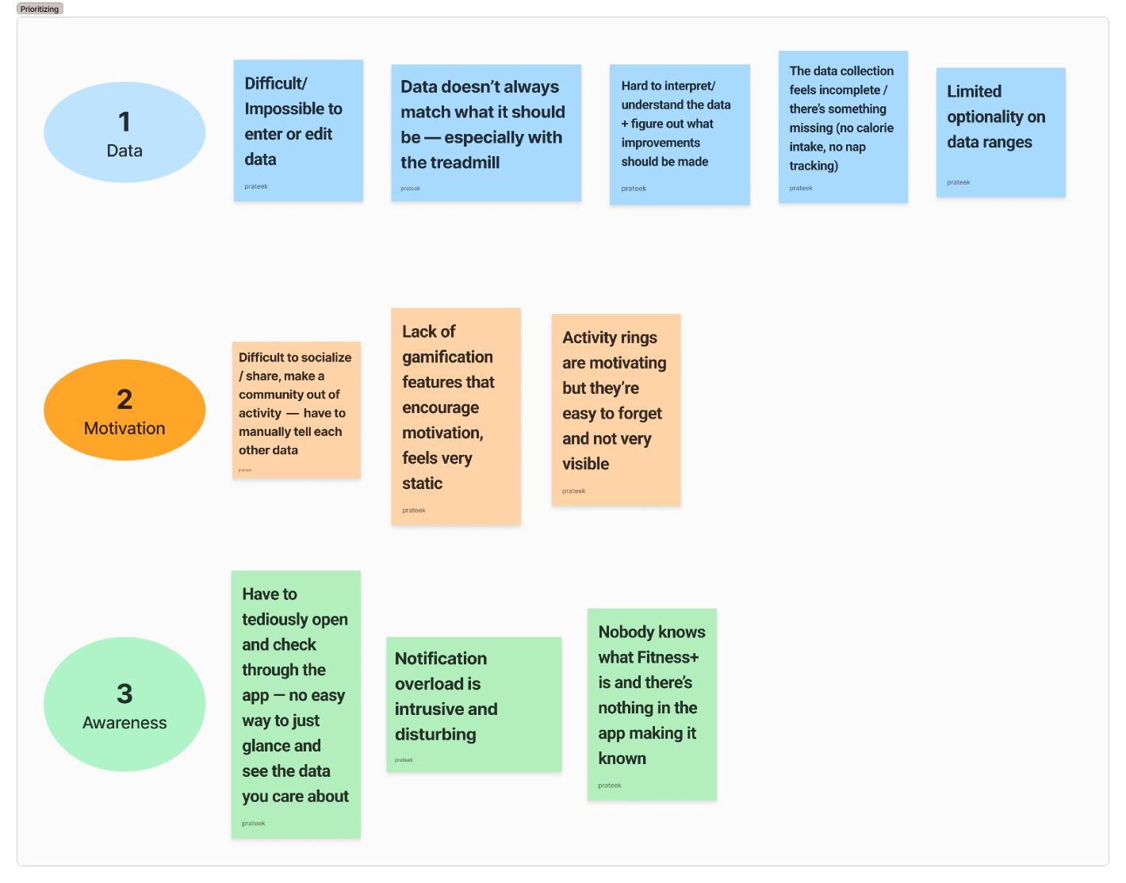

Pain Points
NYU — PMC
9

Slide 10
NYU — PMC
Solution Ideation
10

Slide 11
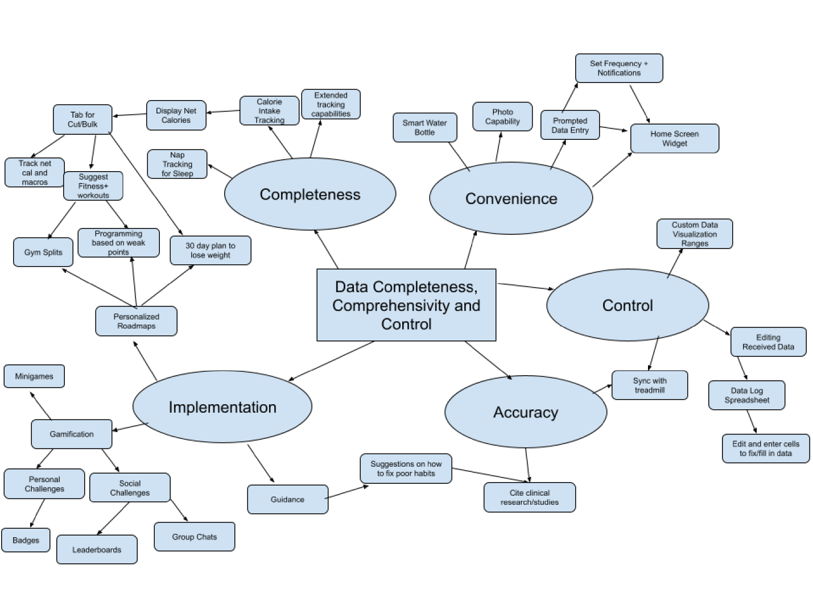
Mind Map — Divergence
NYU — PMC
11

Slide 12
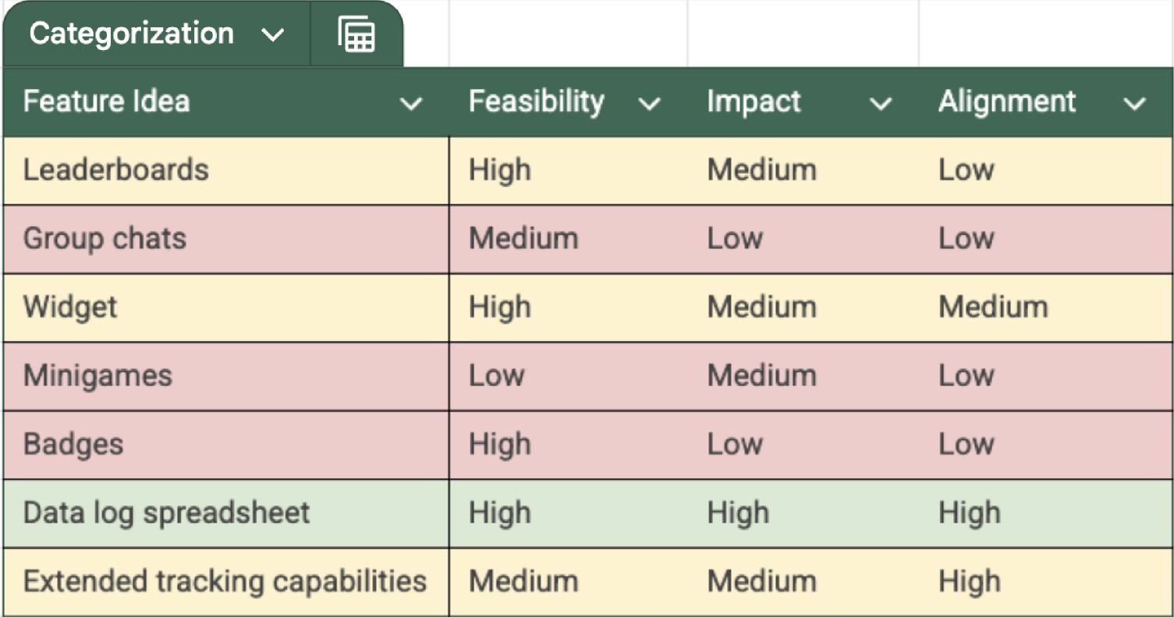
Categorization — Convergence
NYU — PMC
12

Slide 13
NYU — PMC
Value Proposition
13

Slide 14
Value Proposition
“I want to do the least amount of manual work possible”
Mia Loran
“I think personally, the spreadsheets might be a little overwhelming”
Saijel Burkett
“I don’t want to access any other app, like you can just see [past data] on the app”
Eric Tsai
”I think it would help me be more aware instead of tracking willy nilly like whatever”
Saijel Burkett
“Right now, I try to look at my previous data but it is not easily accessible”
Mia Loran
For Apple Health users who want a clearer, more controllable view of their long-term wellness data, BioSync: Health Data Log is an interactive calendar-style interface that organizes each tracked metric into an editable, time-based table where users can view monthly summaries, daily averages, and even hour-by-hour data. Unlike FitBit or MyFitnessPal, the Health Data Log lets users fully control their data ranges and visualization, empowering them to navigate effortlessly between past and present trends, customize what’s shown, and gain a more holistic understanding of their health journey.
NYU — PMC
14

Slide 15
NYU — PMC
Feature Idea
15

Slide 16
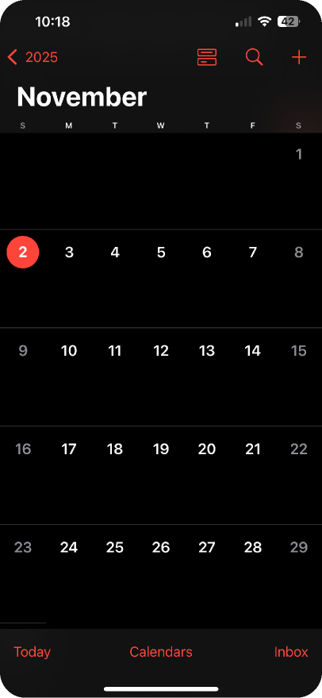
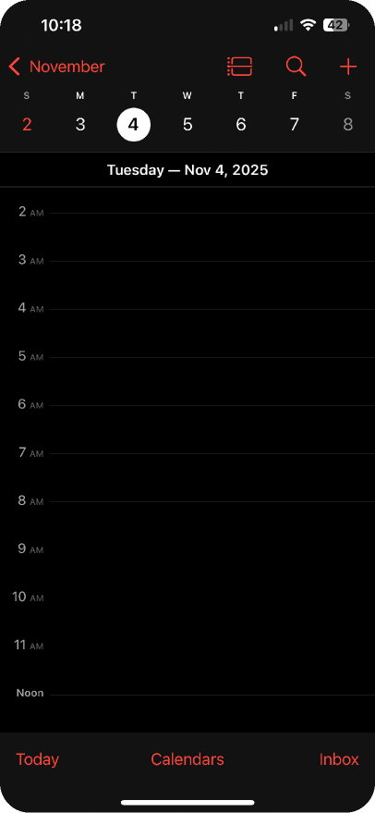


BioSync
Health BioSync is a visually intuitive calendar interface for Apple Health, allowing users to explore lifetime historical health data with hourly detail, visualize custom data ranges, and quickly identify wellness trends—making long-term health review as seamless as browsing events in Apple Calendar.
NYU — PMC
Lifetime Health History
Calendar view/hourly breakdown
Custom dashboards
Custom ranges
16

Slide 17
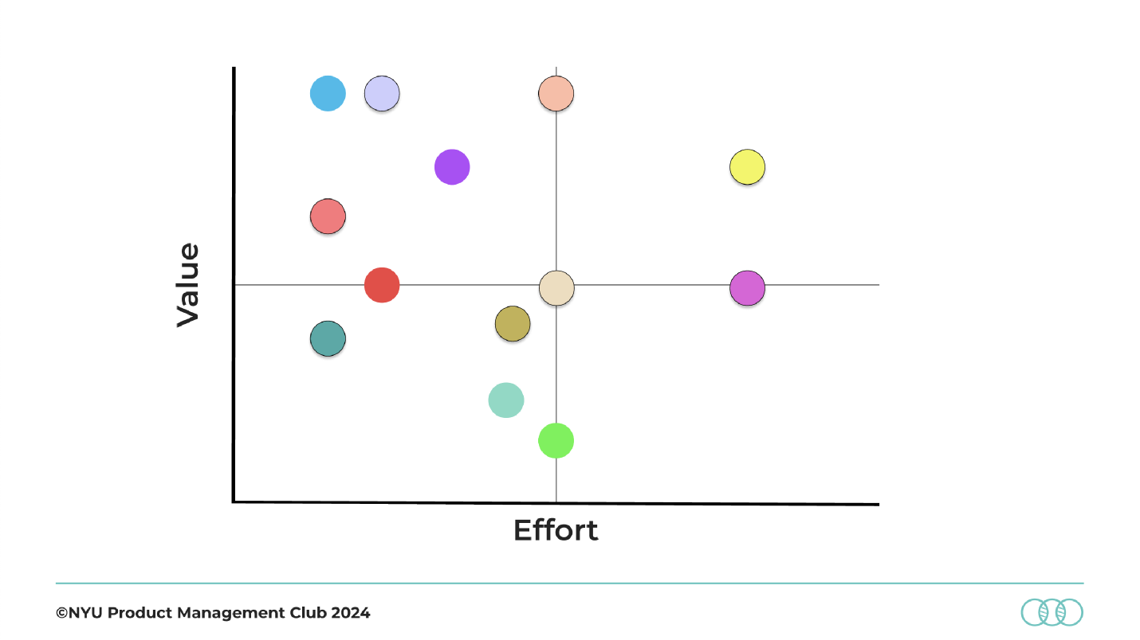
MVP Feature Prioritization
Are users taking control of their health through data visibility and accessibility?
Trends
Pinning
Health History
NYU — PMC
Ranges
Calendar View
Hourly
17

Slide 18
MVP Feature Prioritization
Are users taking control of their health through data visibility and accessibility?
NYU — PMC
Complete Health History
Calendar View
Provides users with access to their entire health data record from the day they started tracking, enabling long-term trend analysis.
Displays health metrics in an intuitive calendar format, making it easy for users to navigate by date and compare metrics over time.
Hourly Breakdown
Custom Data Ranges
Trend Summaries
Offers granular hourly details for continuous health metrics, allowing users to identify specific daily patterns.
Allows users to filter and view data for custom time periods, enabling focused analysis on relevant timeframes.
Automatically surfaces patterns and trends in user data, providing actionable insights without requiring advanced analysis skills.
18

Slide 19
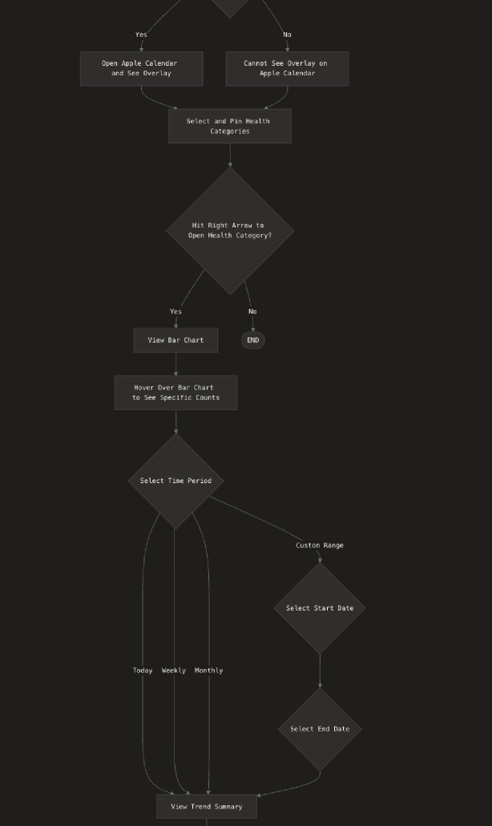
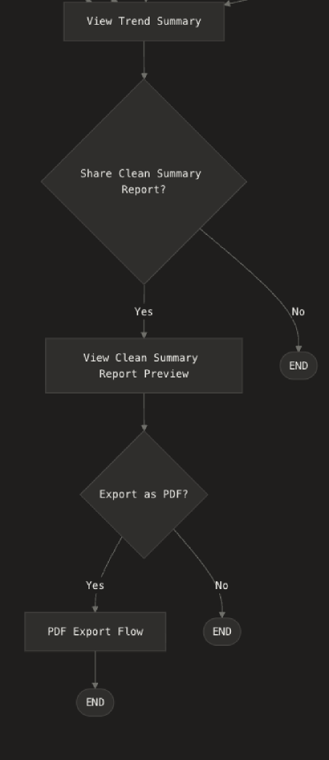
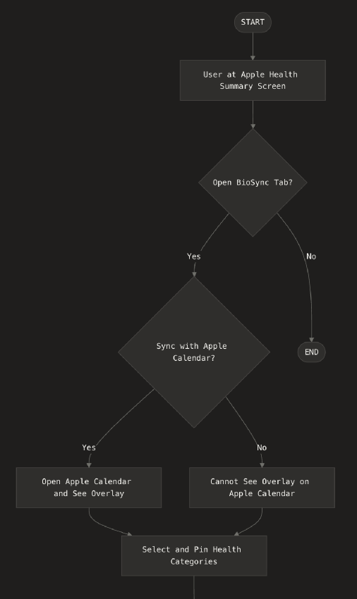
User Flow
NYU — PMC
19

Slide 20
Prototype
https://biosync-prototype.lovable.app
NYU — PMC
20

Slide 21
NYU — PMC
Key Performance Indicators
21

Slide 22
KPIs
How is success and performance going to be measured?
Weekly Open Rate
Average Session Duration
Calendar Integration Conversion
NYU — PMC
Measures how frequently users open BioSync each week
Is the feature a must-have that is being interacted with frequently or is it decorative?
How much is the feature actually being used?
Measures how long users actively engage with the BioSync per visit
Is the feature just being glanced at or are users interacting with it?
Does data customization lead to longer, more productive sessions?
Measures the rate at which users are syncing their health data into their calendar app
Is the feature something users want to keep front of mind and visible or is it not worth incorporating?
Are users caring more about their awareness of their health?
22

Slide 23
NYU — PMC
Stakeholder Management
23

Slide 24
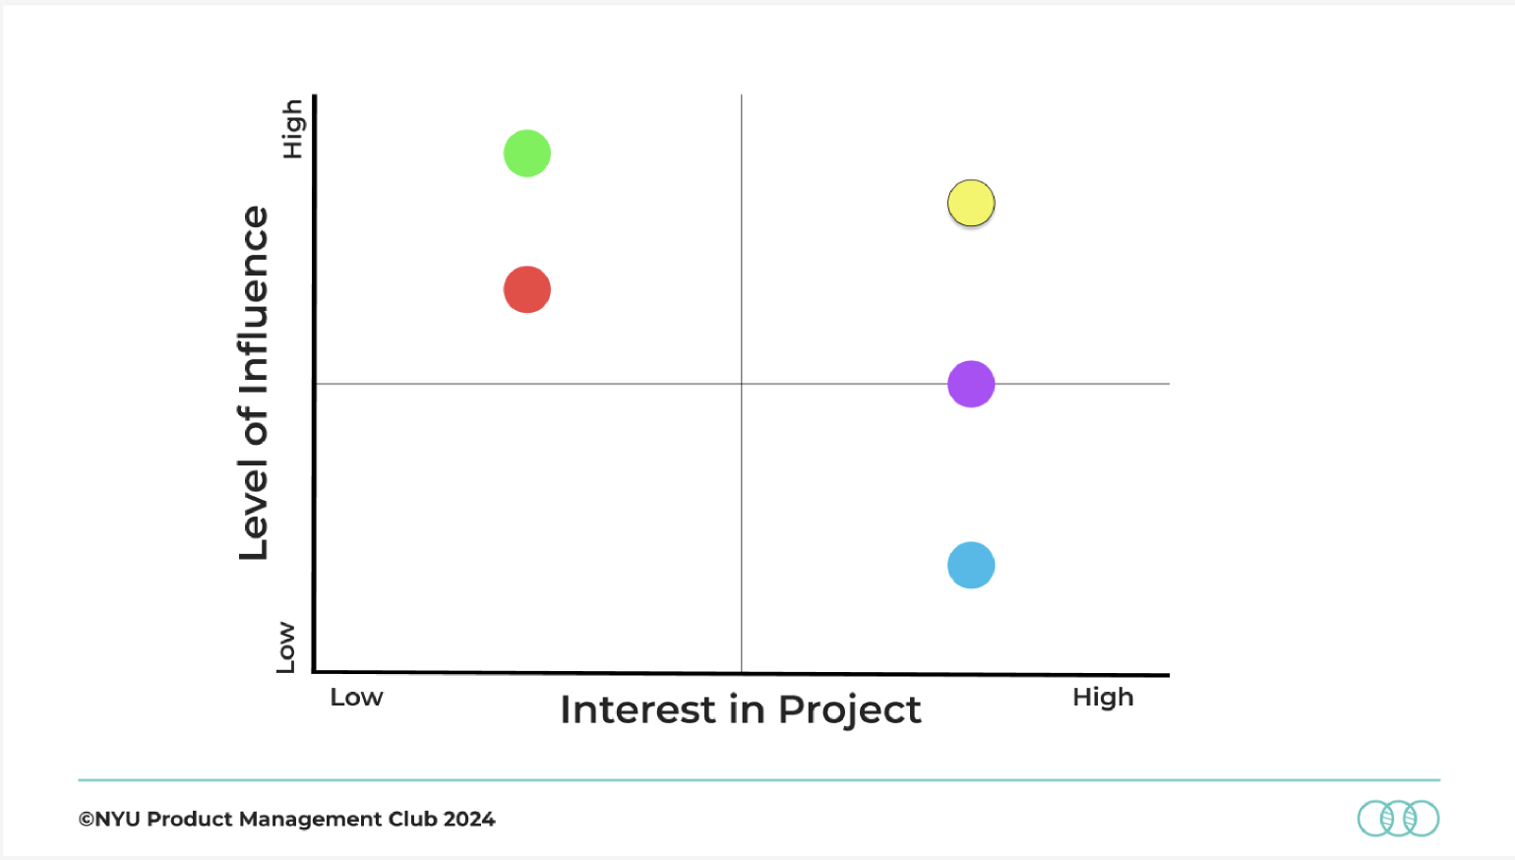




Stakeholder Map
Compliance
Engineering
NYU — PMC
Design
CEO/Execs
Users
24

Slide 25
NYU — PMC
Roadmapping
25

Slide 26
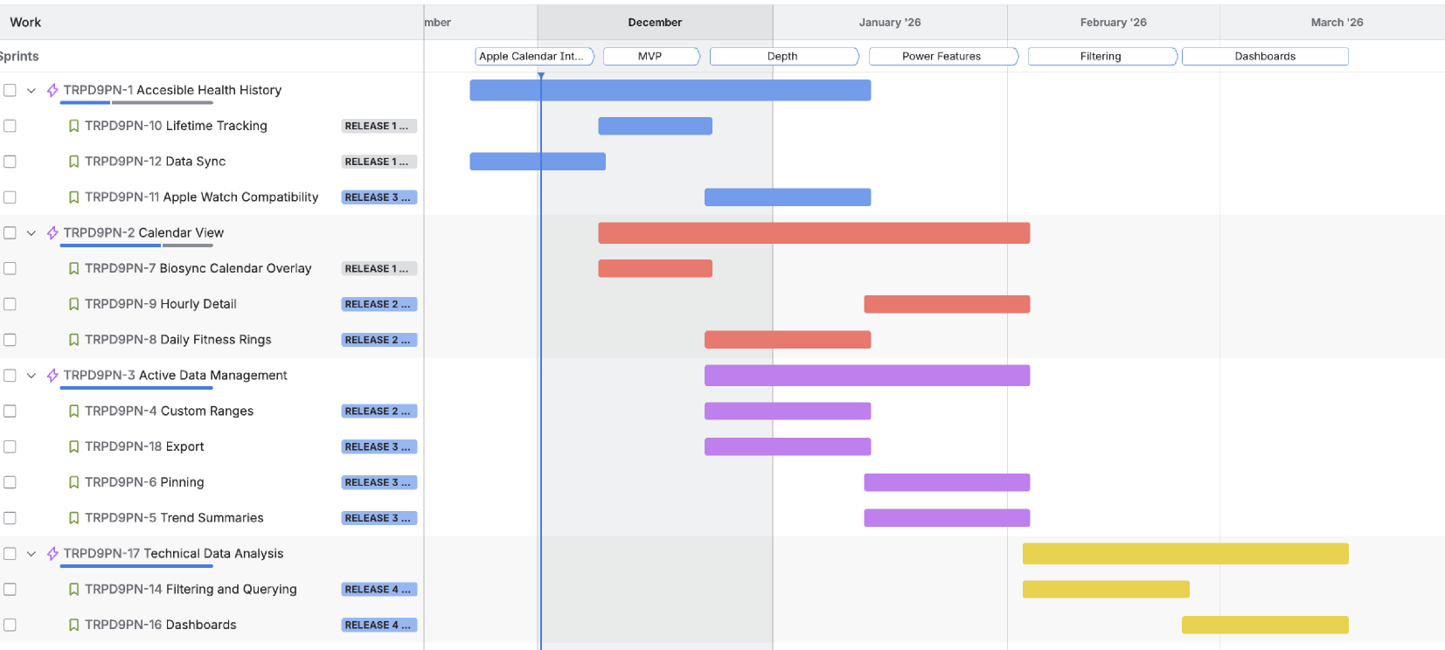
Roadmap
NYU — PMC
26

Slide 27
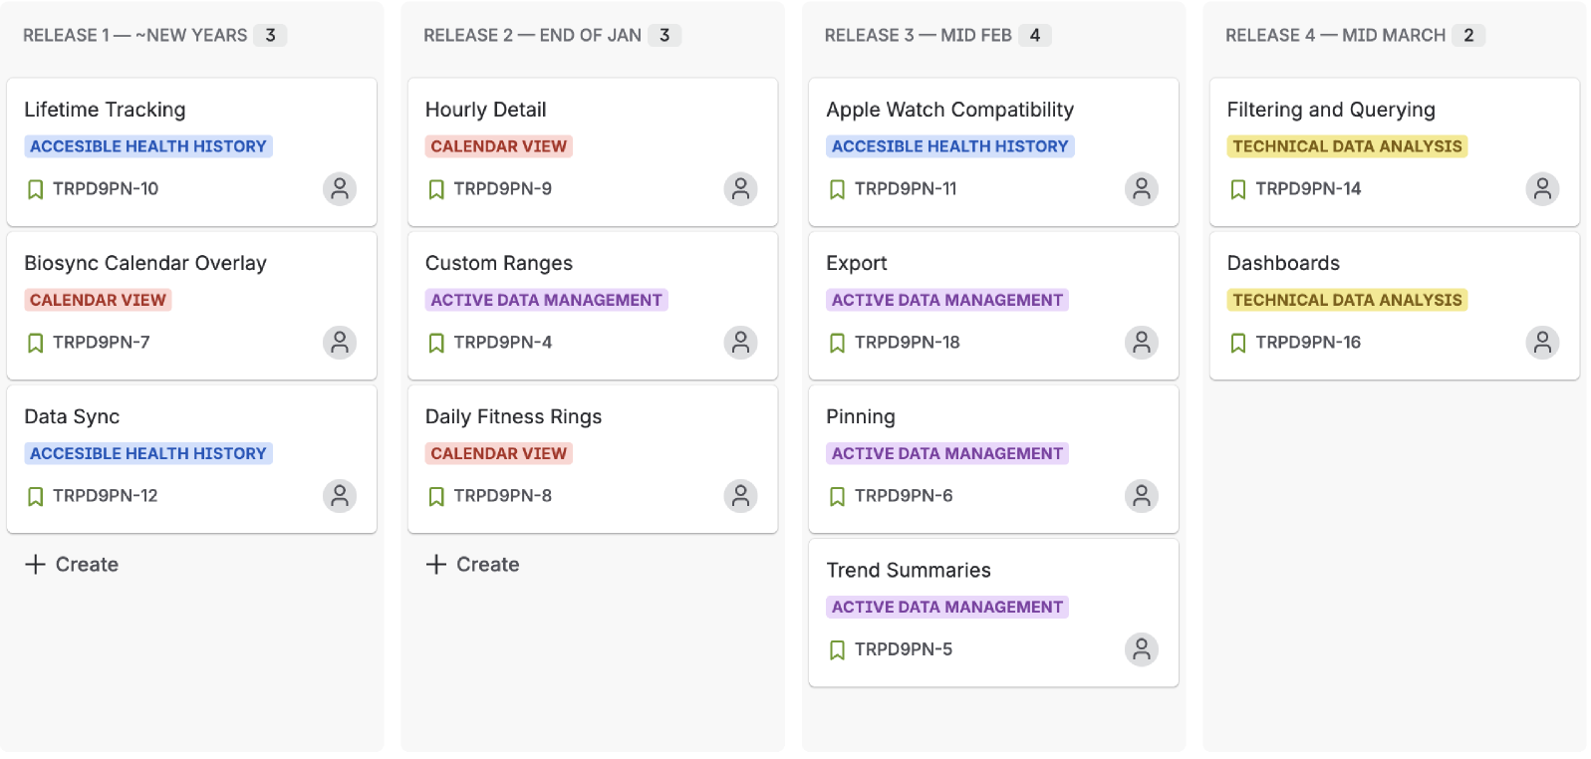
Release Plan
NYU — PMC
27

Slide 28
NYU — PMC
Growth and Revenue
28

Slide 29
Growth
Objective 1:
Increase user stickiness between apps (Health and Calendar) for elevated retention and engagement.
KR1:
  Increase CTR of the “Open Calendar” button in the Health app from 50% to 75%.
KR2:
  Decrease buffer time between switching apps from 25 sec to 10 sec.
KR3:
  Achieve an average frequency of Biosync Calendar interactions/visits of 2x a week per user.
Objective 2:
Increase user control and interaction with their Health data to drive sales of wearables (Apple Watch).
KR1:
  Increase average use of custom ranges from 6x a year per user to 10x a year per user.
KR2:
  Achieve a % increase in exports of 10% across all users.
KR3:
  Achieve a margin of error of 0.01 units in data tracking.
NYU — PMC
29

Slide 30
Revenue
Feature Revenue Drivers
Locks users into Apple’s ecosystem
Inter-connection between the Health app and the Calendar app
  User stickiness
Technical features + power features can be put behind a premium model
Greater care for long-term health → Apple Watch purchases
Fitness+ Revenue Growth
Increase the value of the Fitness+ subscription
Only subscribers can see their daily activity rings on the calendar overlay
NYU — PMC
30

Slide 31

Thank you!
Email
Mobile
pn2418@nyu.edu
(408) 717-2980
©2025 NYU PMC Product Team

